Slide 1

United International University
Image Forgery Detection Using Deep Learning
Sheikh Zameer Hossain (ID: 011 152 017)
Sheikh Shwapnil Musa (ID: 011 151 042)
Fathima Akther (ID: 011 151 233)
Abu Nayeem Shohag (ID: 011 151 227)
Supervisor
Prof. Dr. Mohammad Nurul Huda

Slide 2
What is image forgery?
Alternation of semantic components of a digital image.
Removing contents from the image.
Adding data to the image.

Slide 3
Types of Forgery:
Retouching
Image Splicing(Copy-Paste)
Image Cloning(Copy-Move)

Slide 4
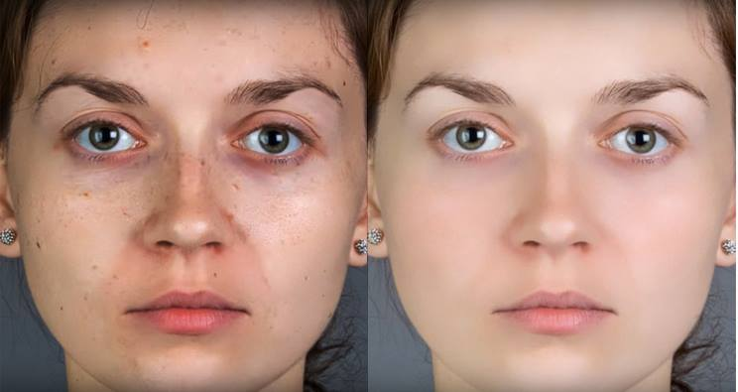
Image Retouching
One of the oldest types of image forgery.
Use to enhance or reduce image features.
Consider less dangerous types of image forgery.

Slide 5
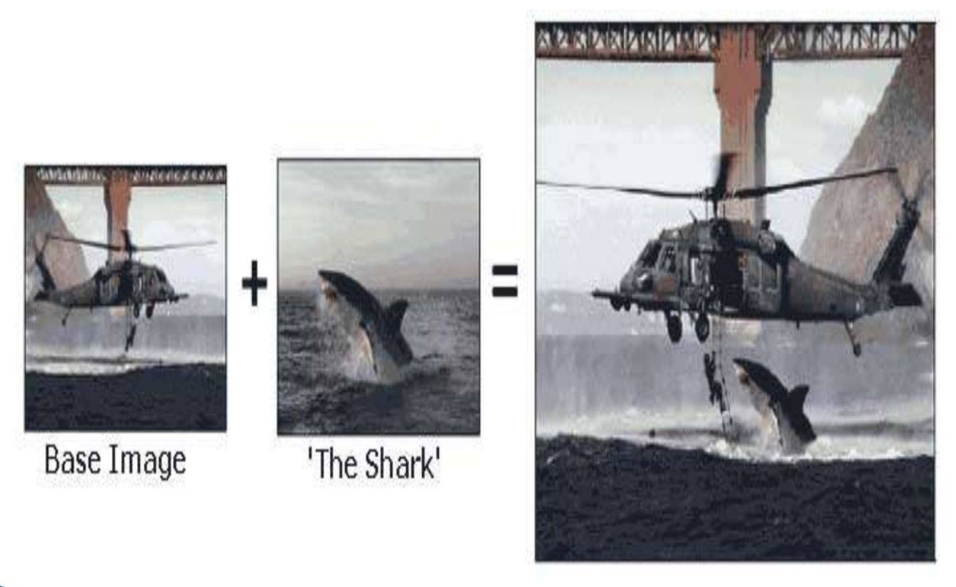
Image splicing(copy-paste)
This technique is more aggressive than image retouching.
A composite of two or more images which are combined to create a fake image.

Slide 6
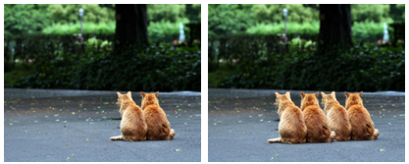
Image Cloning(copy-move)
Copy move attack is more or less similar to image slicing.
Parts of the original image is copied, moved to desired location and pasted.

Slide 7
Description:
We have proposed several methods for detecting forged images
using deep learning. Those are :
CNN
GAN
RNN CNN Hybrid
LSTM CNN Hybrid
Pretrained CNN

Slide 8
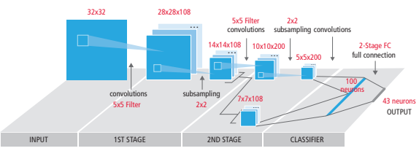
Typical Diagram of CNN:

Slide 9
Layers of CNN:
Convolution layer
Pooling layer
RELU layer
Fully Connected Layer

Slide 10
Convolution Layer :

Slide 11
Pooling layer:

Slide 12
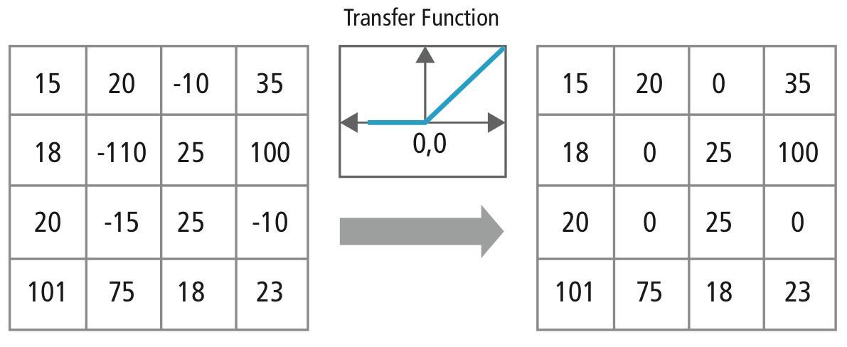
RELU layer:

Slide 13
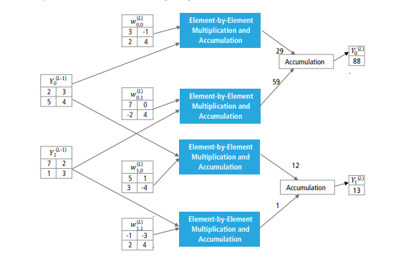
Fully Connected Layer:

Slide 14
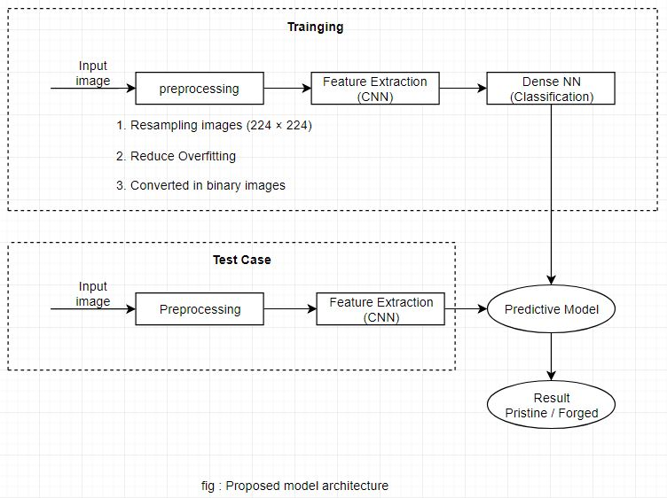
CNN Model:

Slide 15
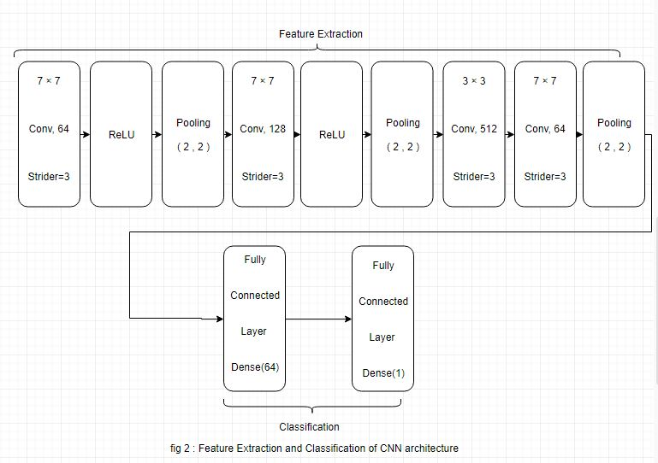
Feature Extraction:

Slide 16
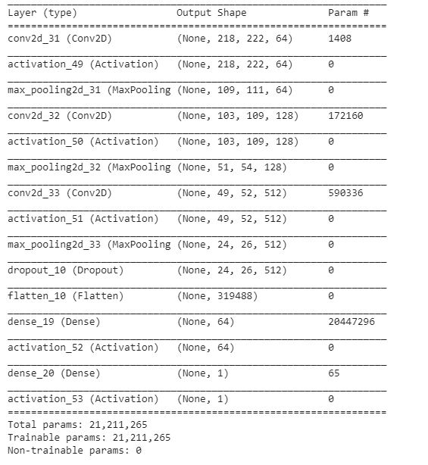
Model Summery:

Slide 17
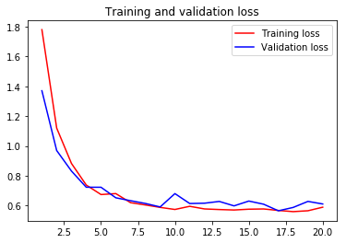
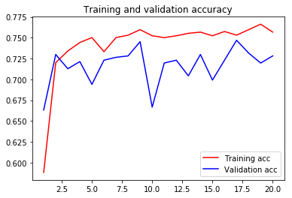
Accuracy & Loss of CNN

Slide 18
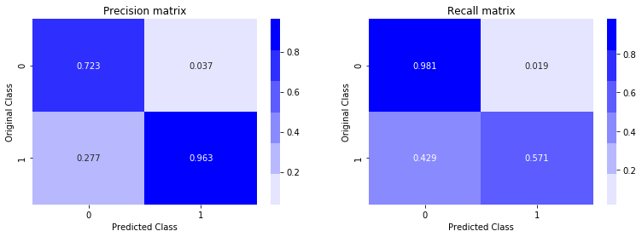
CNN’s Confusion Matrix

Slide 19
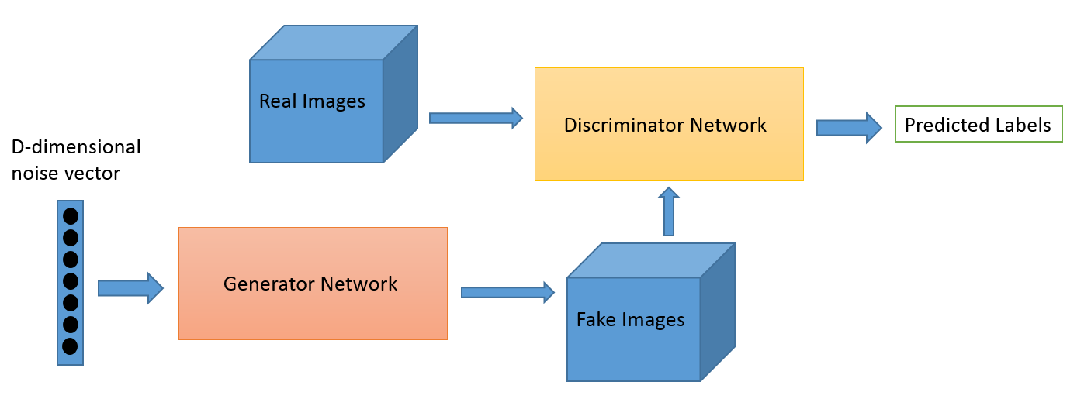
General Adversarial Network(GAN):
Two Entities:
Generator
Discriminator
Fig : Block Diagram of GAN

Slide 20
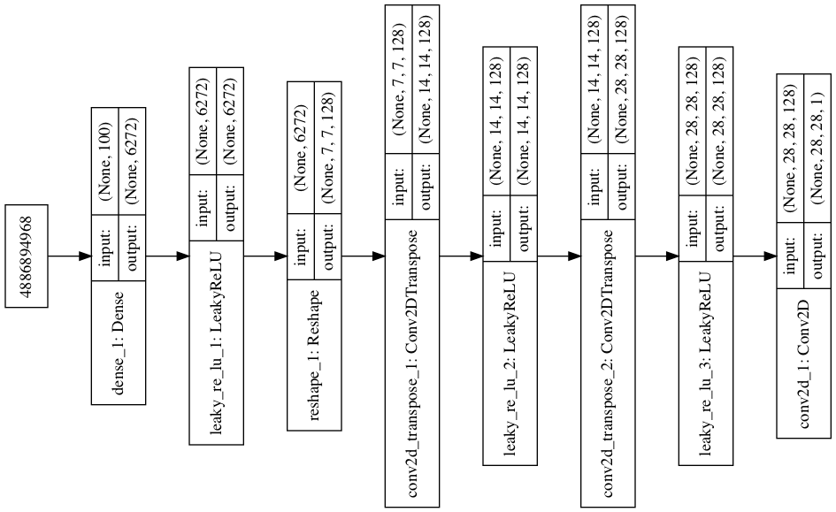
Layers of GAN :

Slide 21
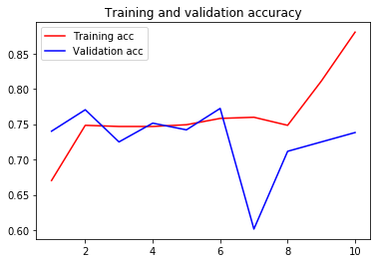
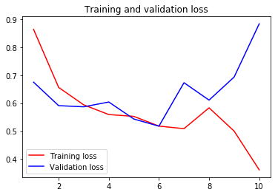
Accuracy & Loss of GAN :

Slide 22
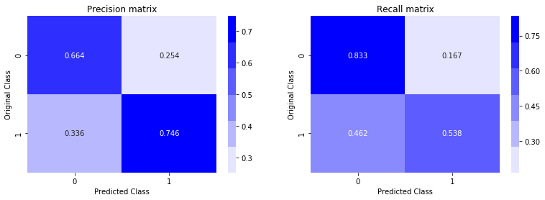
GAN’s Confusion Matrix

Slide 23

LSTM Chain Block:
Fig : Chain Block Diagram of LSTM

Slide 24
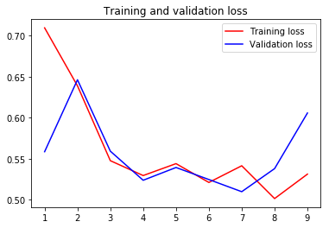
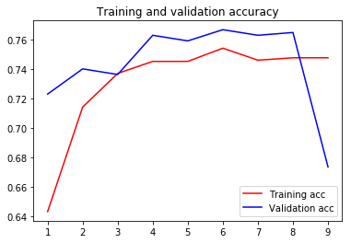
Accuracy & Loss of LSTM :

Slide 25
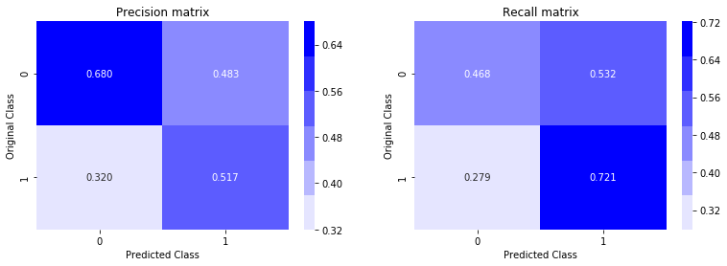
LSTM Confusion Matrix

Slide 26
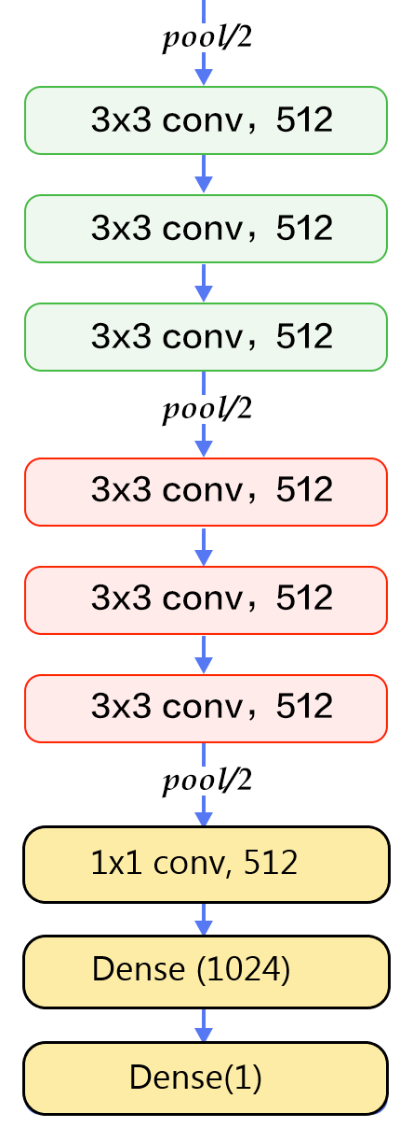
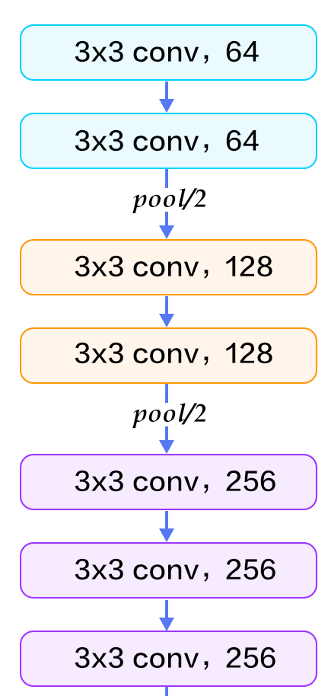
Pretrained CNN Model:

Slide 27
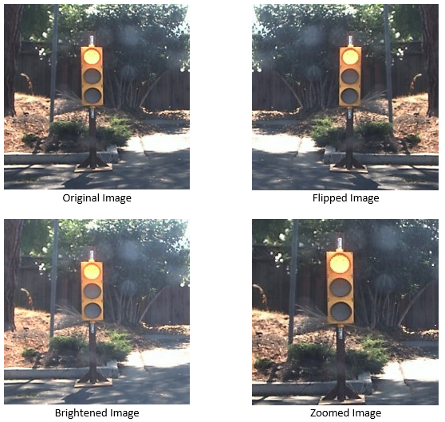
Data Argumentation:

Slide 28
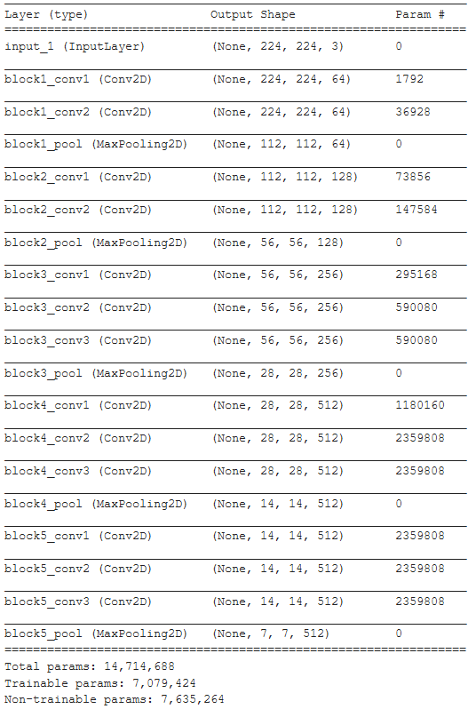
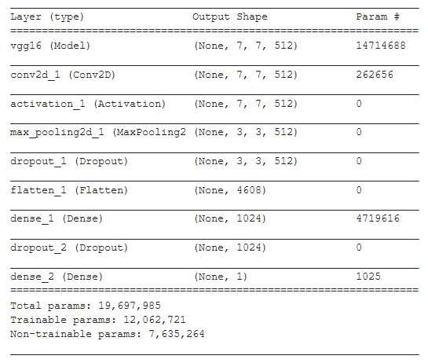
Pretrained CNN’s Summary

Slide 29
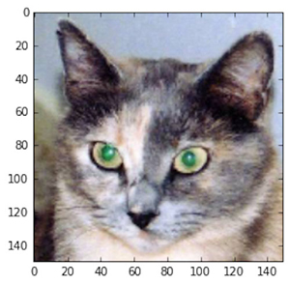
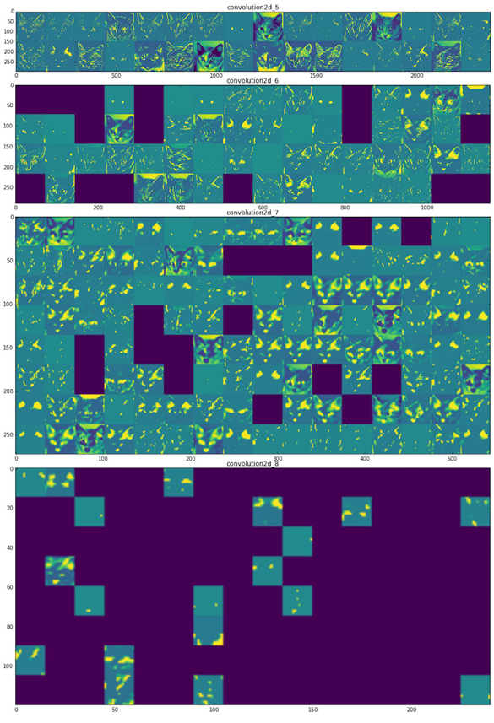
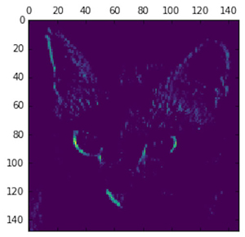
Every Layer Activation:

Slide 30
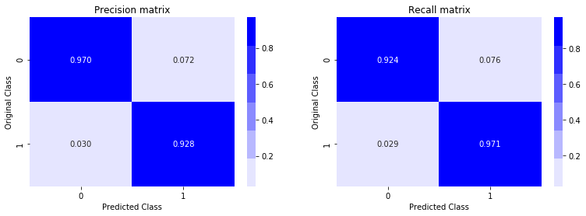
Pretrained CNN’s Confusion Matrix:

Slide 31
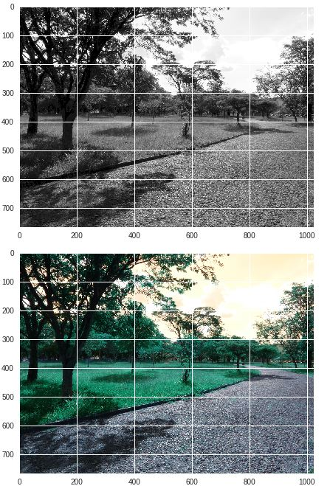
Gray Scaling:

Slide 32
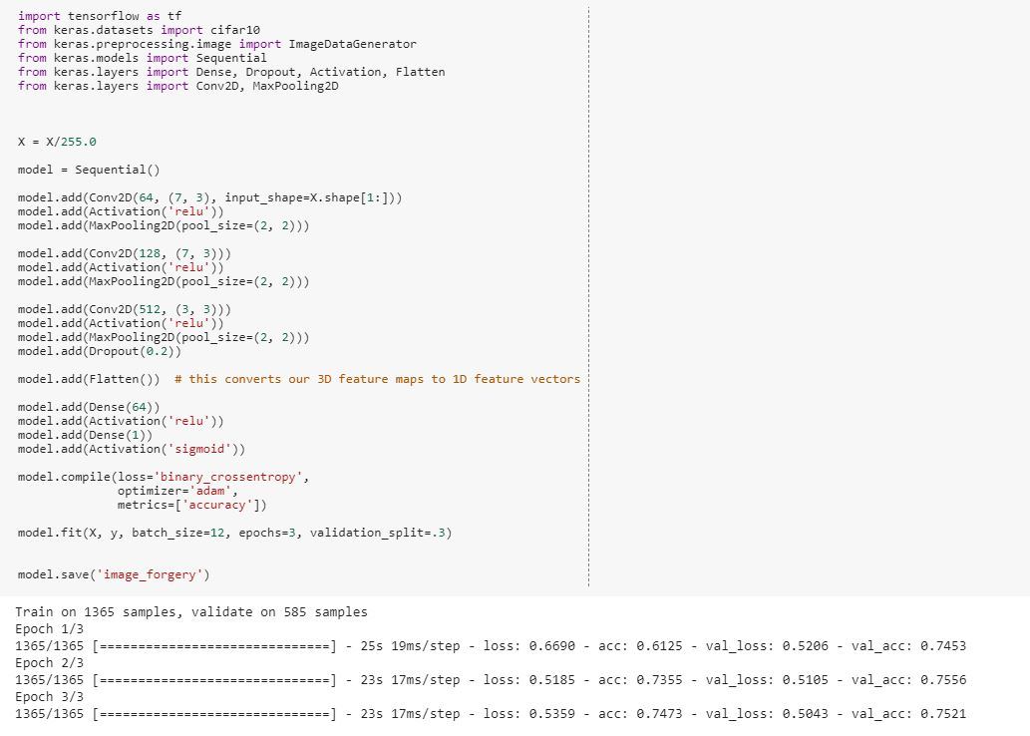
Model Accuracy:

Slide 33
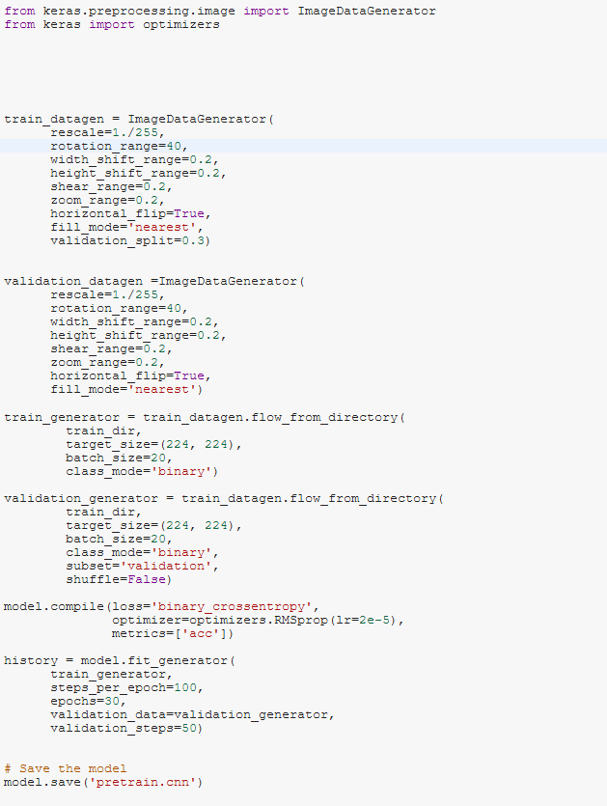
Pre trained model code:

Slide 34
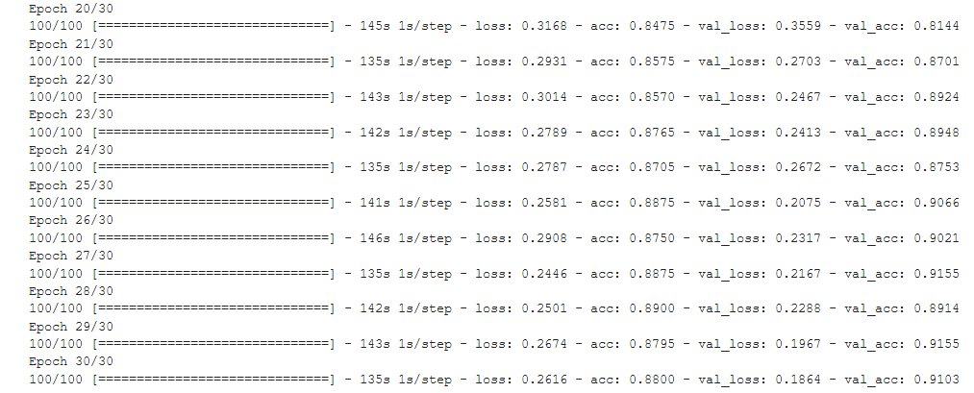
Pre trained model code Accuracy:

Slide 35
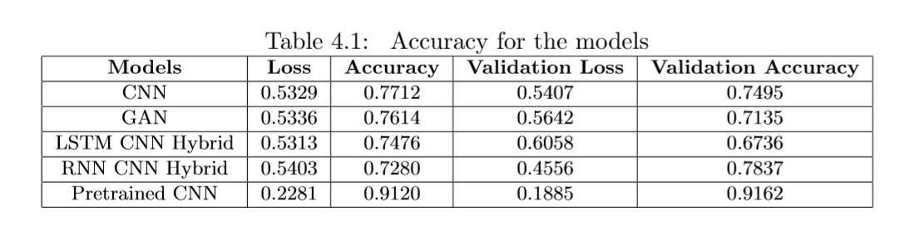
All Model Accuracy Table:

Slide 36
Thank you

